Slide 1
HEART DISEASE PREDICTION
SUPERVISOR:
Dr.Rakesh Roshan.
Assistant Professor.
TEAM MEMBERS
D.Varun(20eg110104)
E.Tejaswini(20eg110106)
V.Srivatsa(20eg110130)
B.Sai Suhas Reddy(21eg510101)

Slide 2
ABSTRACT
According to the World Health Organization, 12 million deaths occur yearly due to heart disease. Load of cardiovascular disease is rapidly increasing all over the world in the past few years. Early detection of cardiac diseases can decrease the mortality rate and overall complications. However, it is not possible to monitor patients every day in all cases accurately and consultation with a patient for 24 hours by a doctor is not available since it requires more patience, time and expertise.
Our Heart disease prediction System is intended to assist patients in recognizing their heart state early and receiving treatment at an earlier stage, allowing them to avoid any serious conditions by using Machine Learning Algorithms.

Slide 3
PROBLEM STATEMENT:
- Heart disease is difficult to recognize due to a variety of risk factors such as high blood pressure, cholesterol, and abnormal pulse rate. Because of the disease's complexity, it must be handled with care. Otherwise, the effects of heart or death may occur.
- Accurate decision-making and optimal treatment are required to address cardiac risk in less Time.

Slide 4
MOTIVATION
- The motivation for this heart disease prediction project lies in utilizing predictive analytics to identify individuals at high risk, empower them with personalized interventions, and make a substantial positive impact on public health by reducing the burden of heart disease.

Slide 5
OBJECTIVE
Prediction of this heart disease is regarded as one of the most important subject.
- So our main objective is to explore the heart disease datasets using exploratory data analysis (EDA) and to design the system using the Machine Learning model.
- To predict the future possibility of heart disease by implementing the Logistic Regression algorithm(Which is highly accurate).

Slide 6
EXISTING SYSTEM
- The existing system for heart disease prediction typically relies on traditional risk assessment models that are based on factors such as age, gender, family history, blood pressure, cholesterol levels, and smoking habits.
- These models, while informative, may have limitations in accurately predicting heart disease outcomes.
- Random Forest : Accuracy – 78.78% .
- Naive Bias : Accuracy – 65.4%.

Slide 7
PROPOSED SYSTEM
- Here, heart disease prediction aims to enhance accuracy, personalization, and efficiency by incorporating advanced technologies and comprehensive data analysis.
-
This system will employ Logistic Regression Algorithm to analyze a wide range of patient data including Features such as Age, sex, chest pain, Fasting blood pressure,ECG,Max_heart rate,oldpeak,slope etc.
Logistic Regression Algorithm provides highly accurate prediction system with 85% More Accuracy in Less Time.

Slide 8
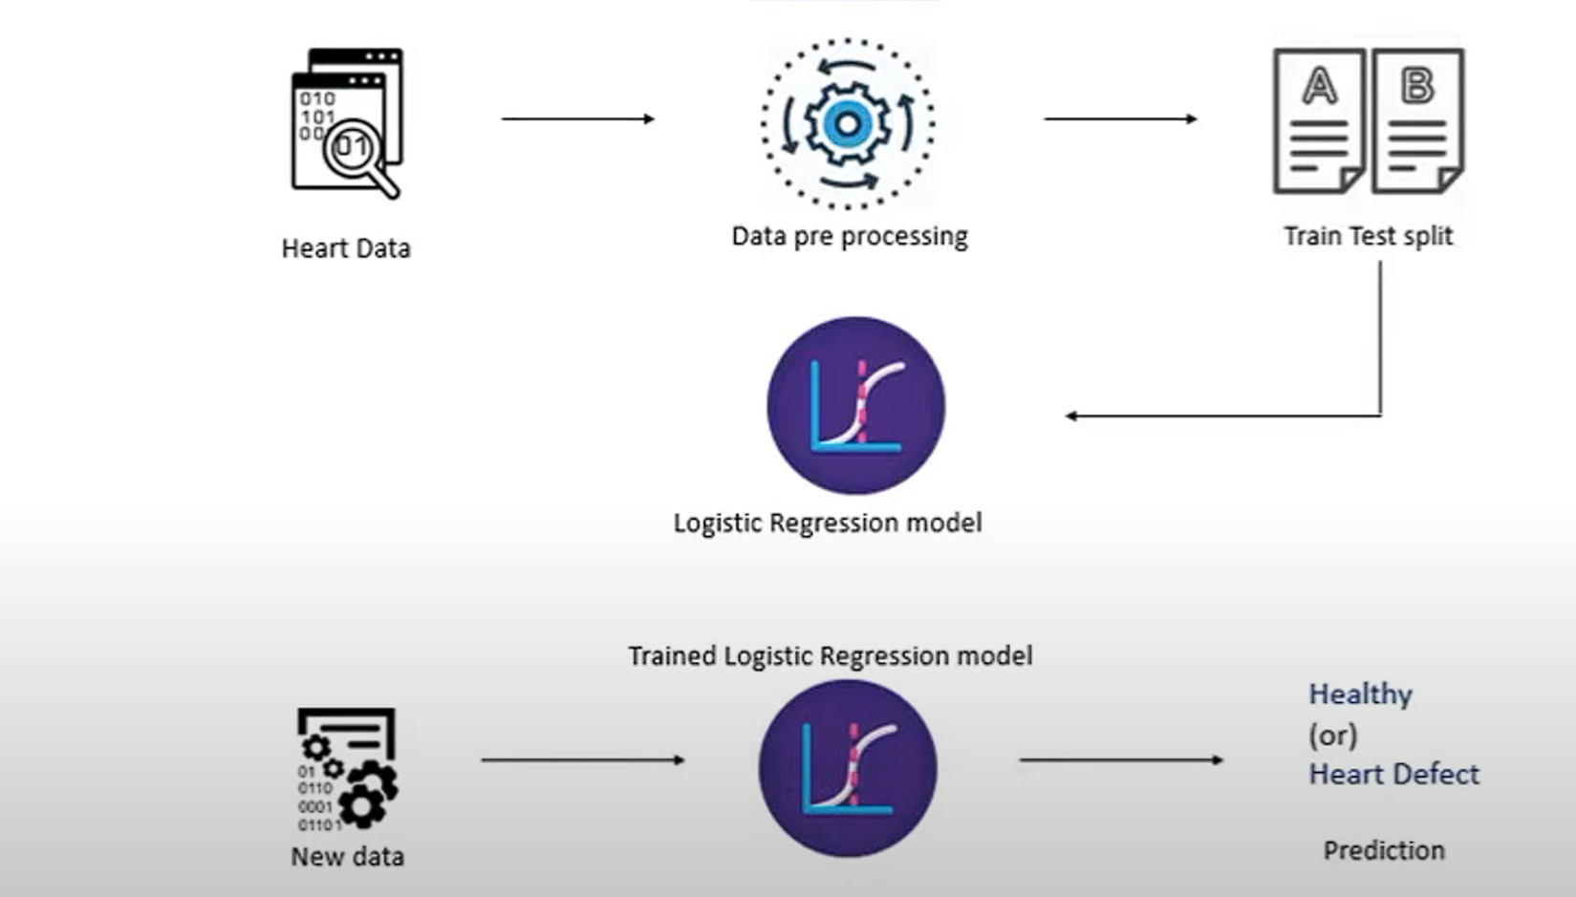
SYSTEM ARCHITECHURE

Slide 9
SOFTWARE REQUIREMENTS
- OperatingSystem : windows 8 and above
- Coding Language used : python
- Algorithms used : Logistic Regression.
HARDWARE REQUIREMENTS
- HARD DISK: 40GB
- RAM : 4 OR 8 GB

Slide 10
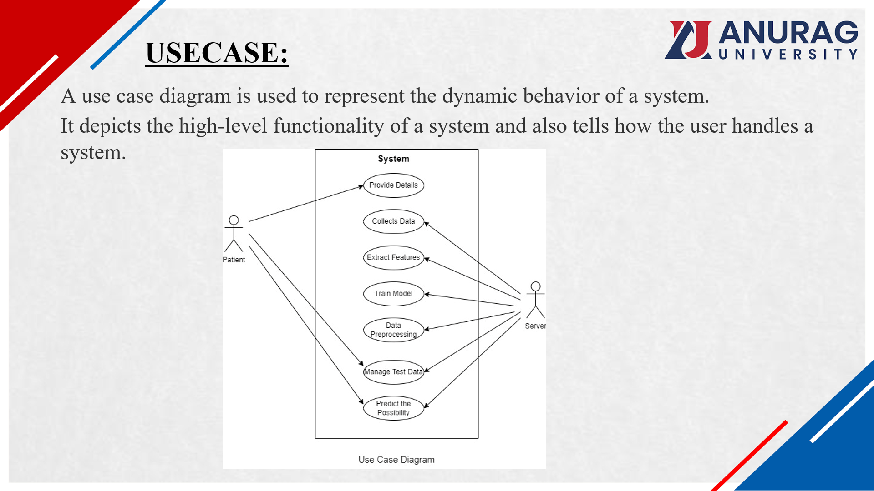

Slide 11
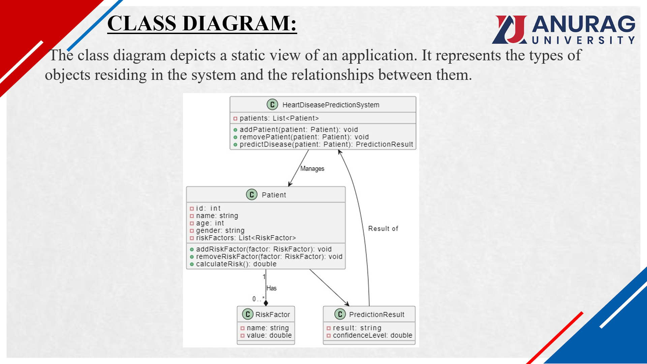

Slide 12
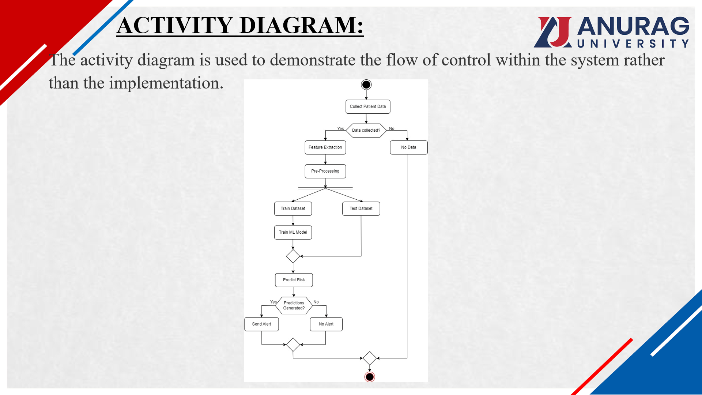

Slide 13
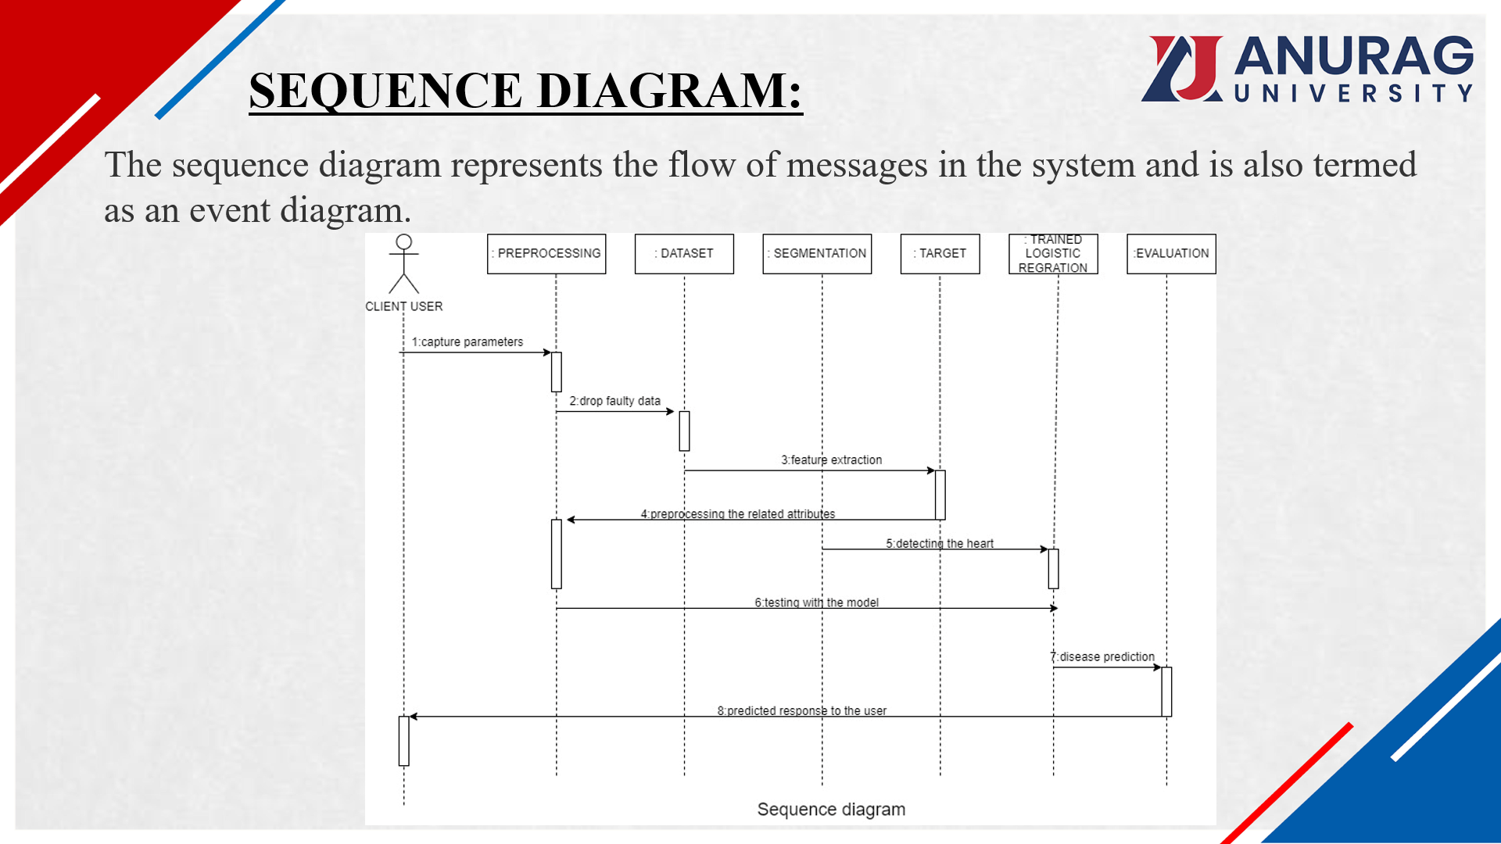

Slide 14
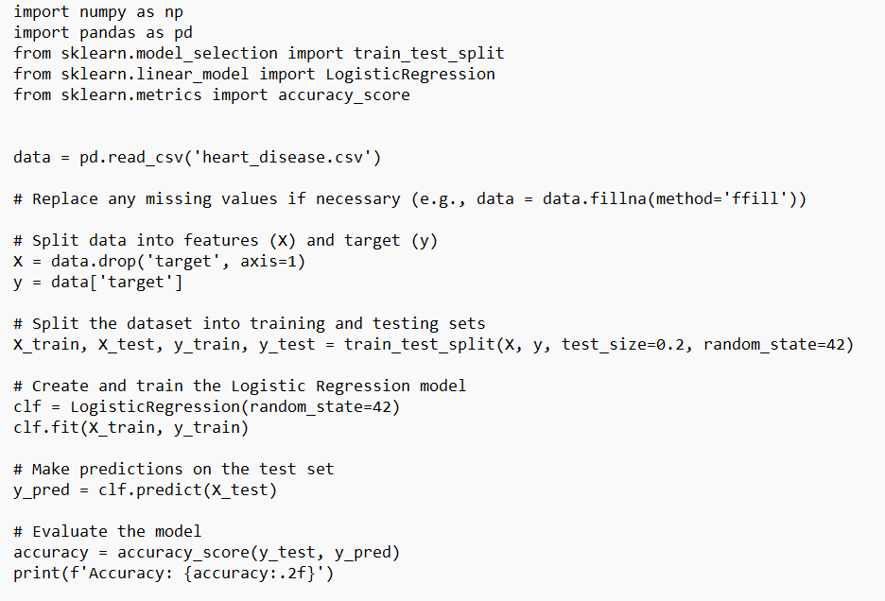
SAMPLE CODE

Slide 15
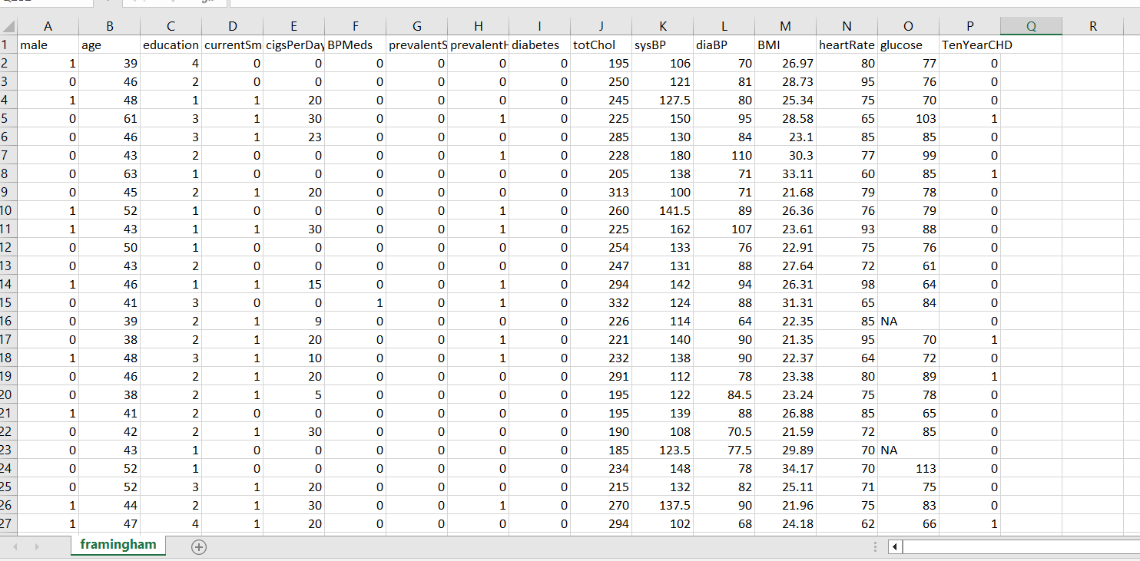
IMPLEMENTATION
Here we are using logistic regression algorithm to predict whether patients having heart disease and to implement this project we are using Heart.csv dataset from UPI Repository.

Slide 16
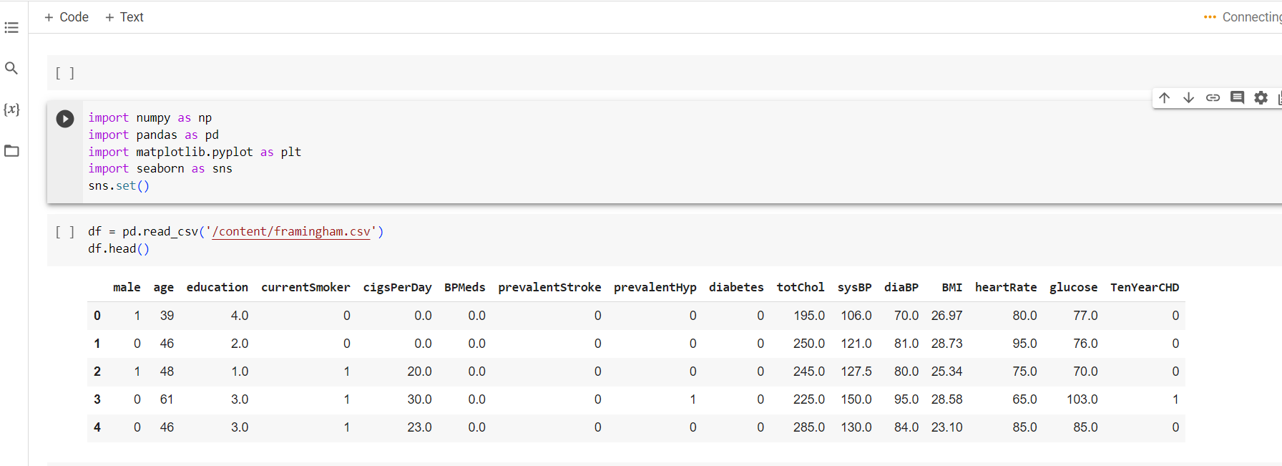
IMPORTING LIBRARIES

Slide 17
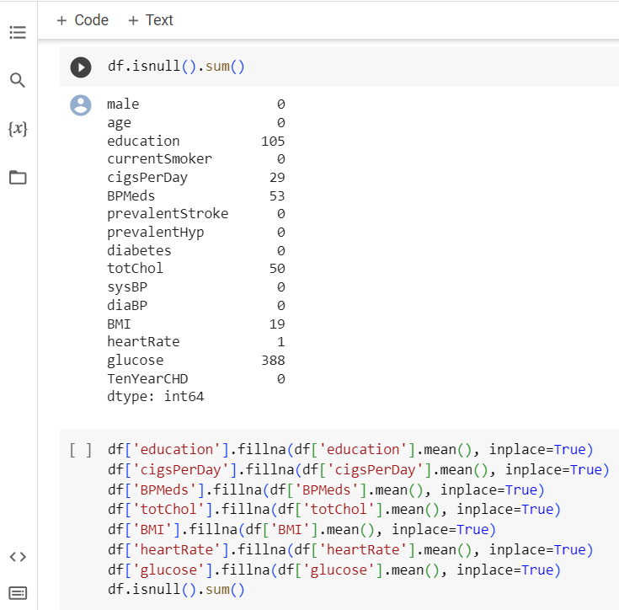
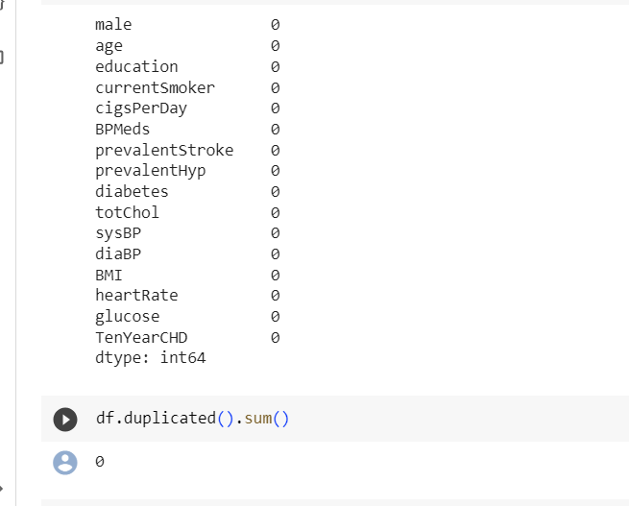

Slide 18
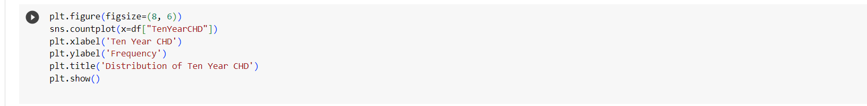
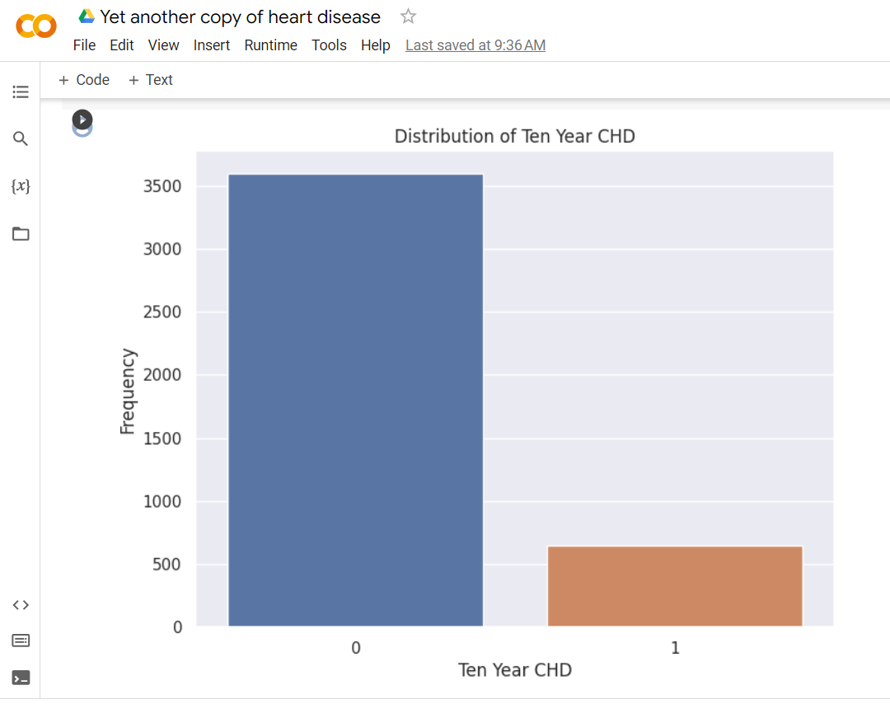

Slide 19
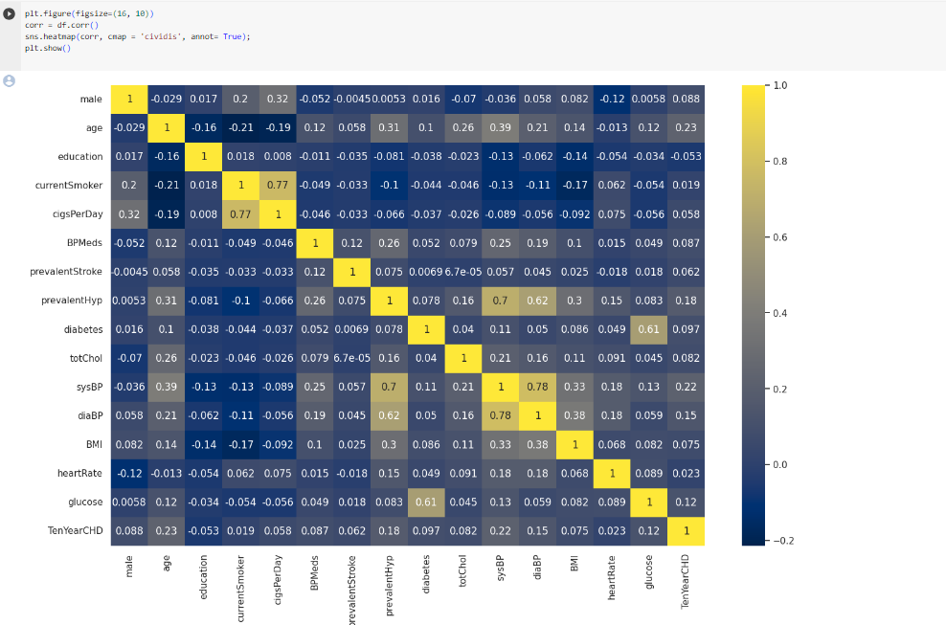

Slide 20
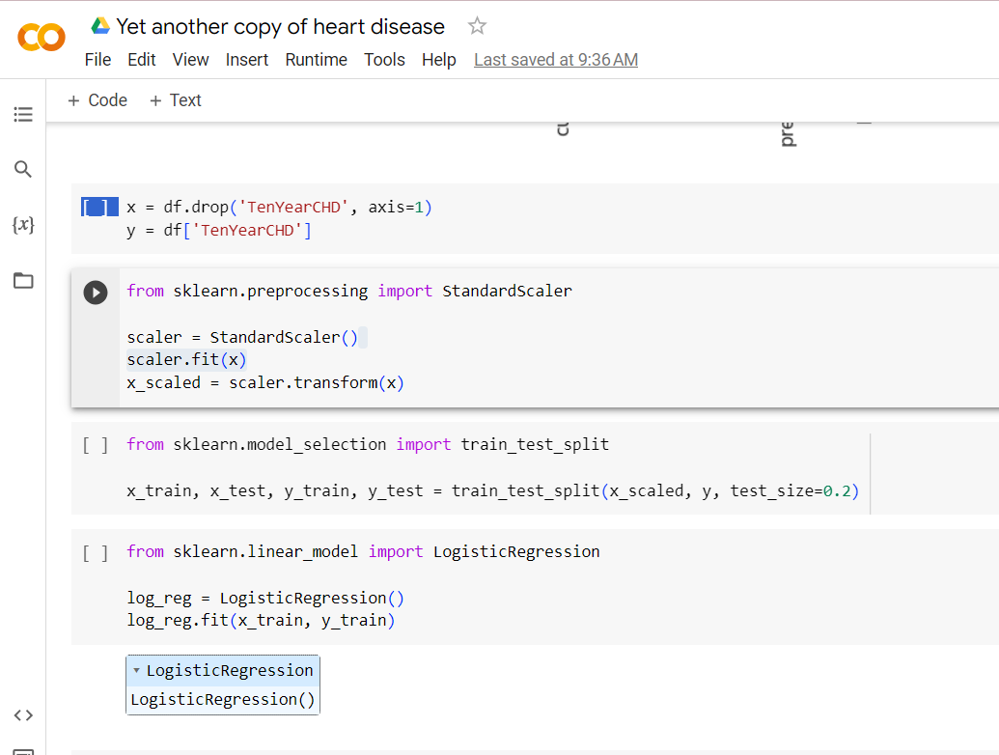
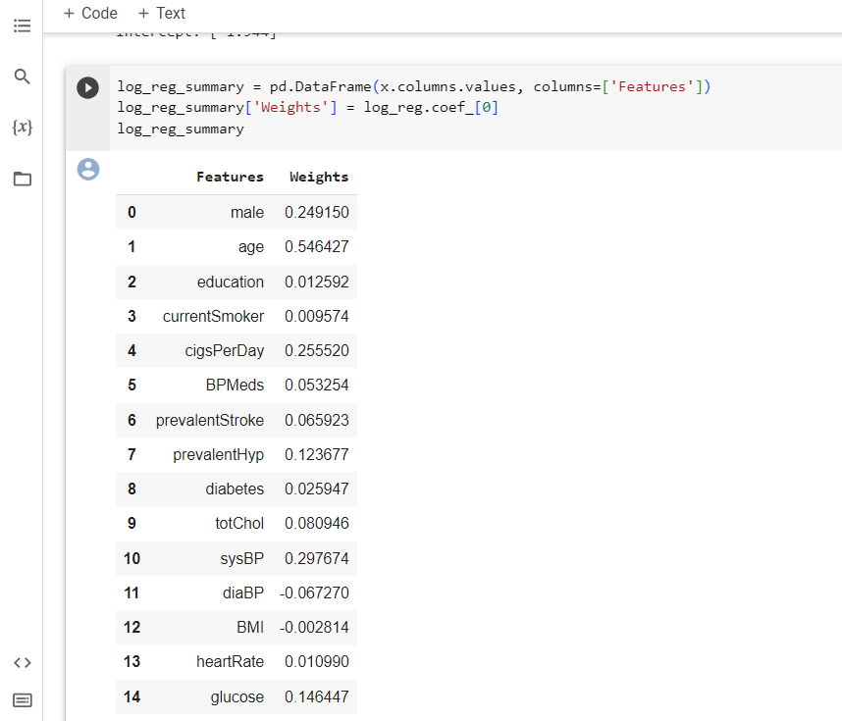
PREDICTION USING MACHINE LEARNING MODEL.

Slide 21
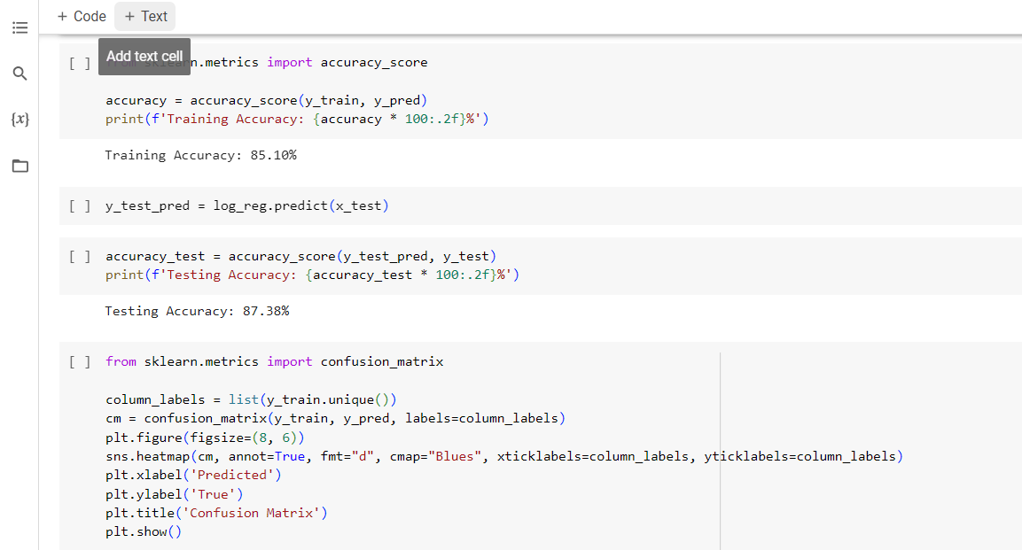
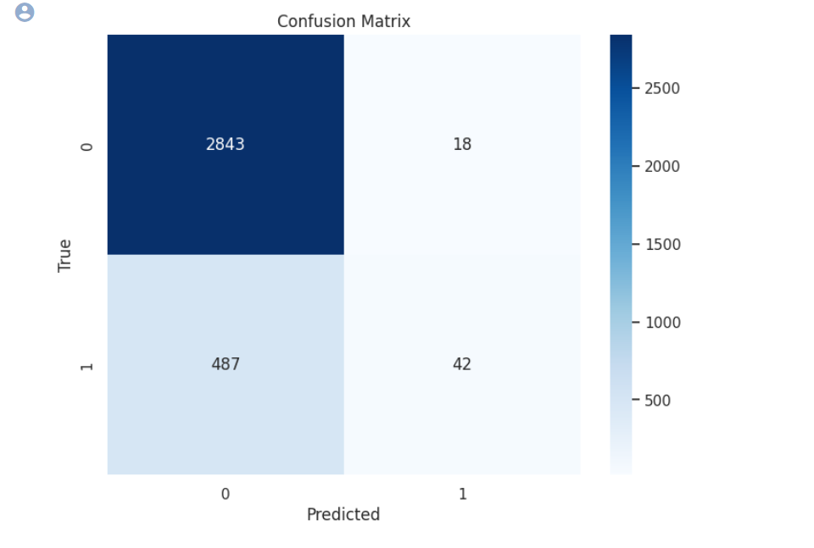
OUTPUT

Slide 22
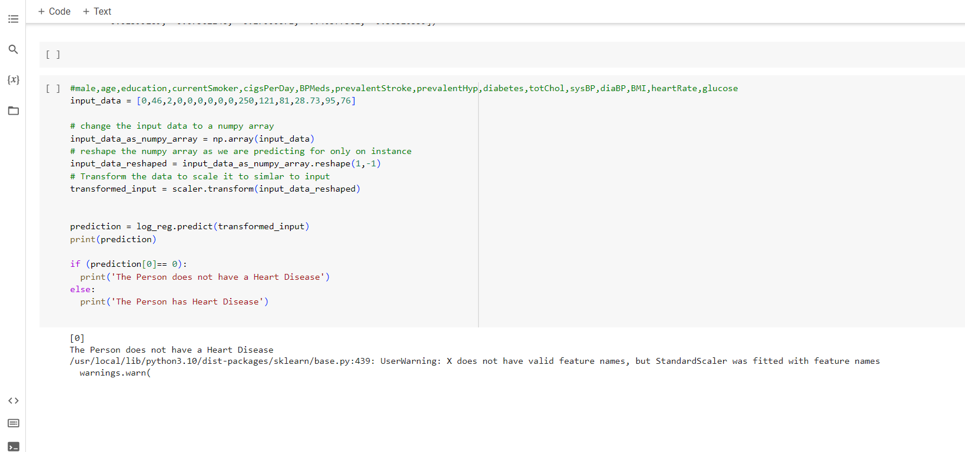

Slide 23
CONCLUSION:
Finally comparing the results We get that accuracy of logistic Regression is about 85% .
Heart diseases are one of the major concerns of society and the number of people affected by these diseases is increasing day by day and it is important to find a solution so with the help of data analytics and machine learning models ,we can determine these diseases and have a better chance of treating it.

Slide 24
THANK YOU

